Slide 1

Amazon: Helping Small Businesses
Group: Fantastic 5
Notes:
© Copyright PresentationGo.com – The free PowerPoint library

Slide 2

Introduction and Background
Data Overview
Data Collection
Data Analysis and Insights
Recommendations

Slide 3

Background
“Three out of every 10 small businesses in the U.S. say they likely won‘t survive 2021 without additional government assistance during the coronavirus pandemic”
There are 30.2 million small businesses in the United States, according to the Small Business Administration's (SBA) Office of Advocacy.

Slide 4
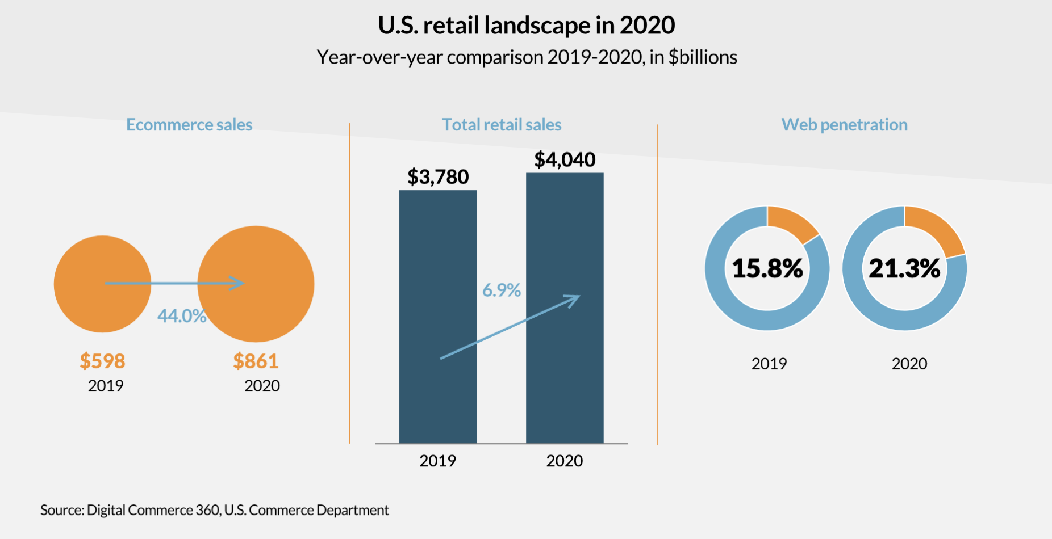
E-Commerce at the forefront of retail
Changing customer spending habits
Additional $175 billion in ecommerce revenue in 2020
$861 billion in ecommerce sales wouldn’t have been reached until 2022

Slide 5
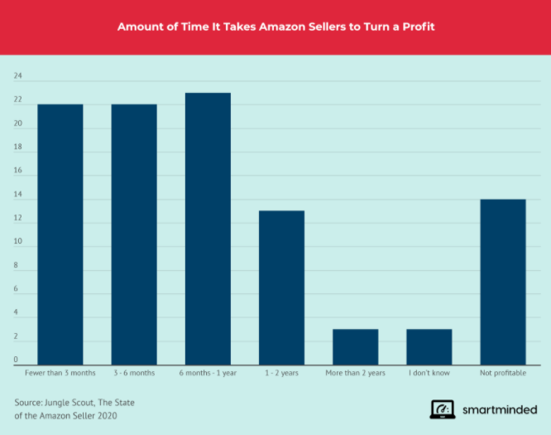
The first issue: highly competitive selling environment
Over 2 million active sellers on Amazon
Extremely hard to find new product niches
Profitable but it takes time
Most sellers (23%) take 6 months to 1 year to be profitable, 13% take 1 to 2 years, and 14% are non-profitable
How to choose a more popular product?
Notes:
Although e-commerce is skyrocketing now, it is not a perfect place for every small business to start selling their products. There are specific issues to sell products on Amazon. Now, I will share them with you. The first issue is the highly competitive selling environment on Amazon. Right now, there are over 2 million active sellers, which means for every single product you can think of, there are probably hundreds of sellers behind it. Because of this fierce competition, it takes time to be profitable. As you can see from this graph, 23% of sellers take 6 months to 1 year to be profitable, 13% take 1 to 2 years, and 14% are not even profitable. Therefore, to be successful on Amazon, the main question is how to choose a more popular product to win the competition.

Slide 6
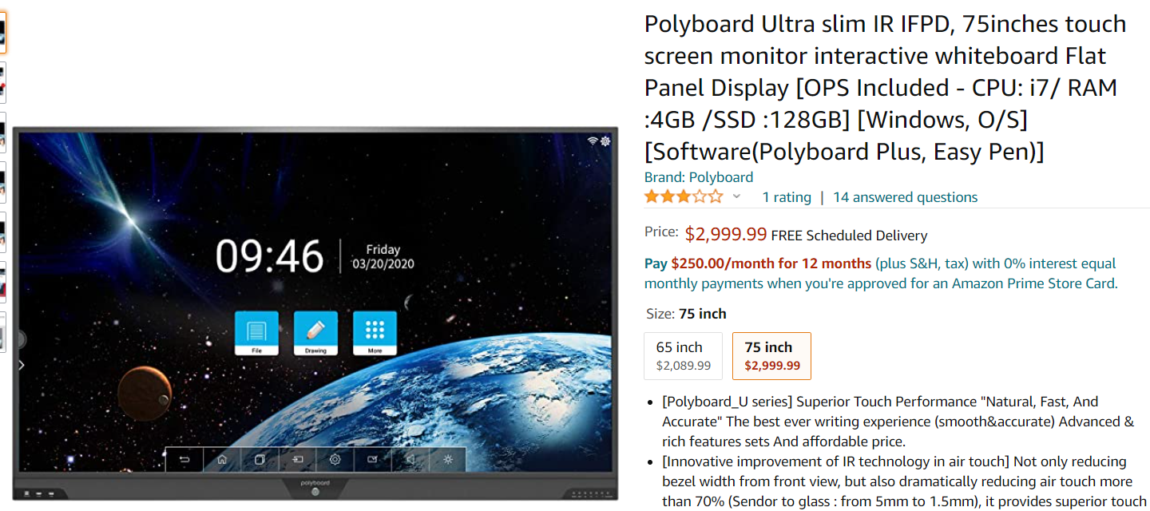
The second issue: products do not sell themselves
Hundreds of same product
Impatient and busy buyers
Writing a successful product description through analyzing customer reviews
Notes:
The second issue is that even if a business has picked a very popular product, there is still intense competition, and without a successful marketing strategy, this product is not likely to appear on the first page of search results. Like I mentioned, there are hundreds of sellers for the same product, so improving the search results rank is very important. One of the most important aspects is the product description, and most small businesses never have experience in writing product description, so we would like to help them in this area through analytics, especially analyzing other same products’ customer reviews.

Slide 7
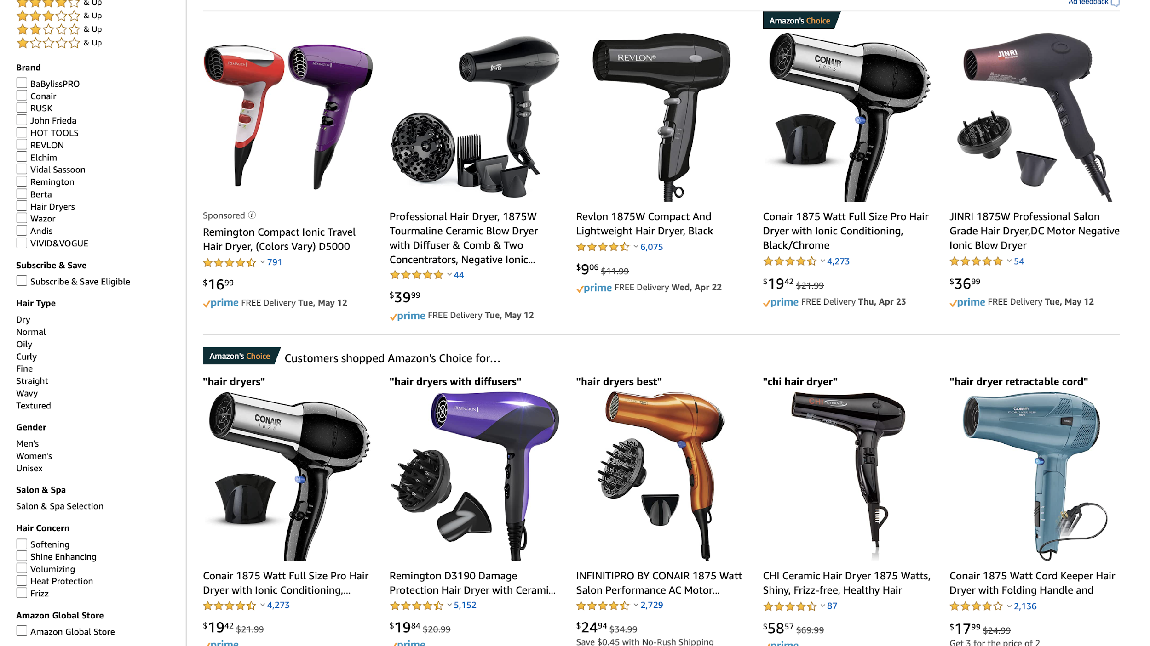
Data Collection Process
Data Source: Customer reviews on Amazon
Pick a specific business case
Hair-dryer business
Notes:
Here, I will briefly go over our data collection process. Our data is mostly customer reviews on Amazon, and we will pick a specific small business to illustrate how we generate our recommendations. Our specific case is about a hair-dryer business because it’s a very common household product, and we could find plenty of data from Amazon. Now, I will pass it to … for

Slide 8
“
How to help small businesses transit to the e-commerce platform?
”

Slide 9
What customer reviews can tell us:
How’s the current market?
What’re possible product features to notice?
What’re the possible advertising strategies?

Slide 10
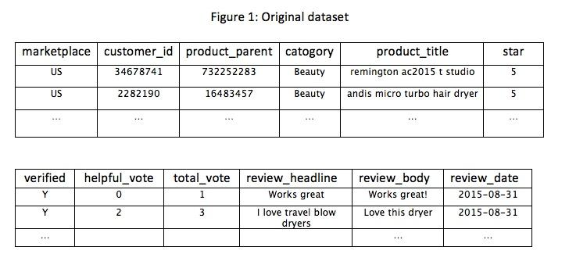
Dataset Overview
11407 data entries

Slide 11
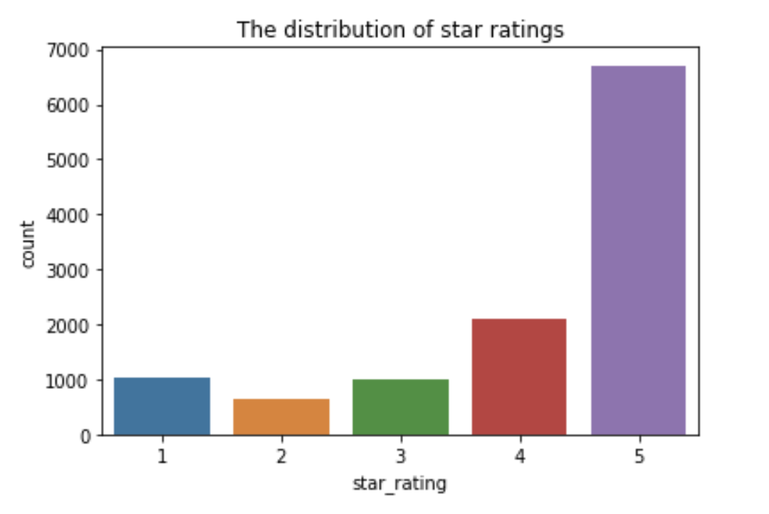
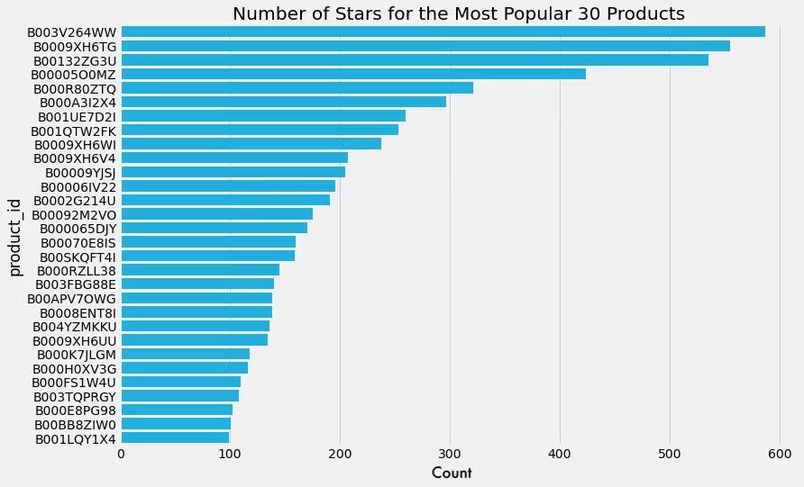
Overview of the Current Market
Majority of reviews are positive
No dominant products

Slide 12
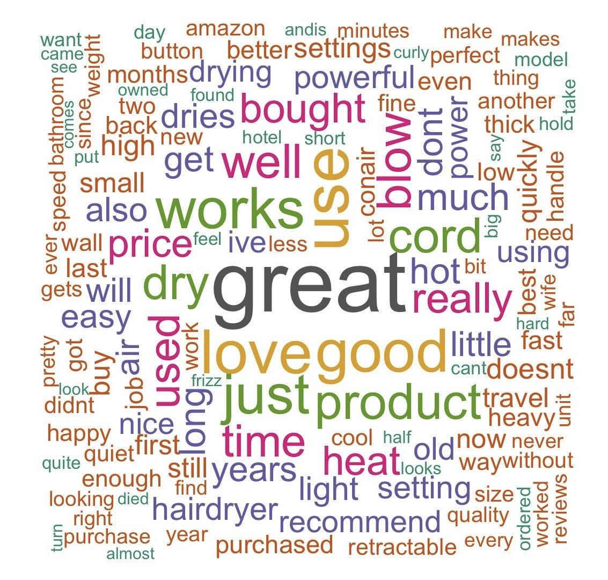
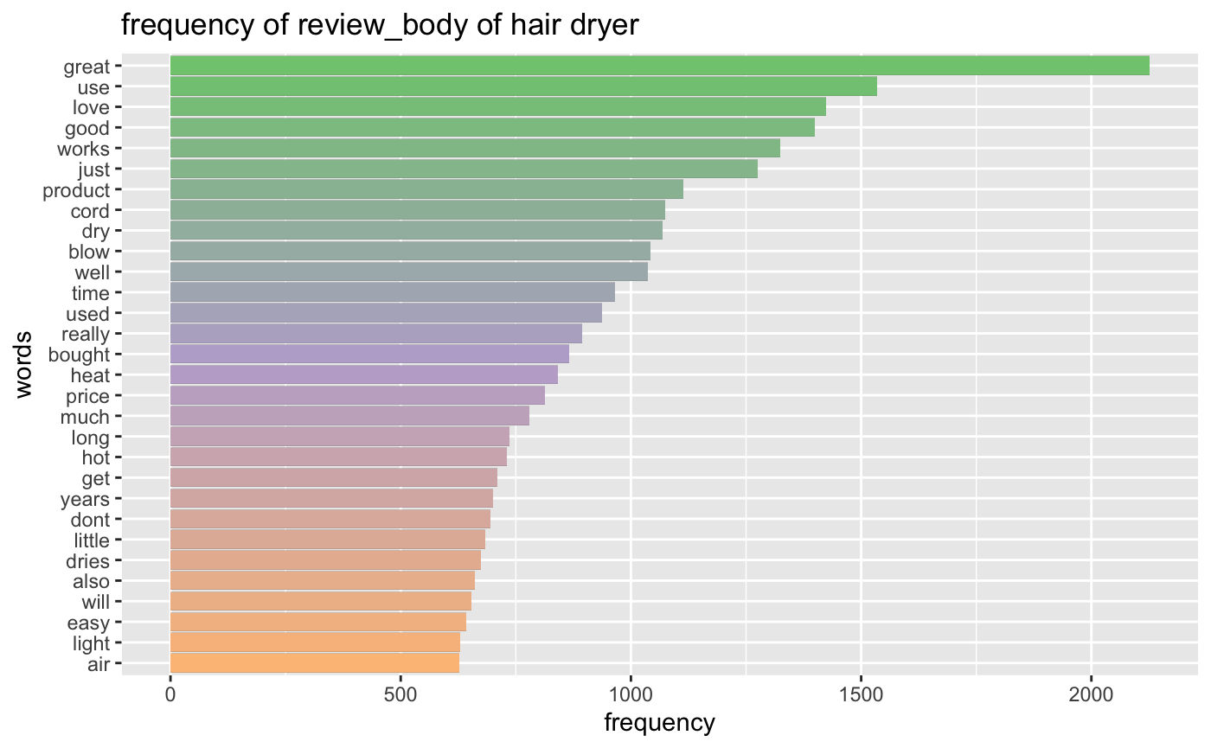
Review Overview

Slide 13
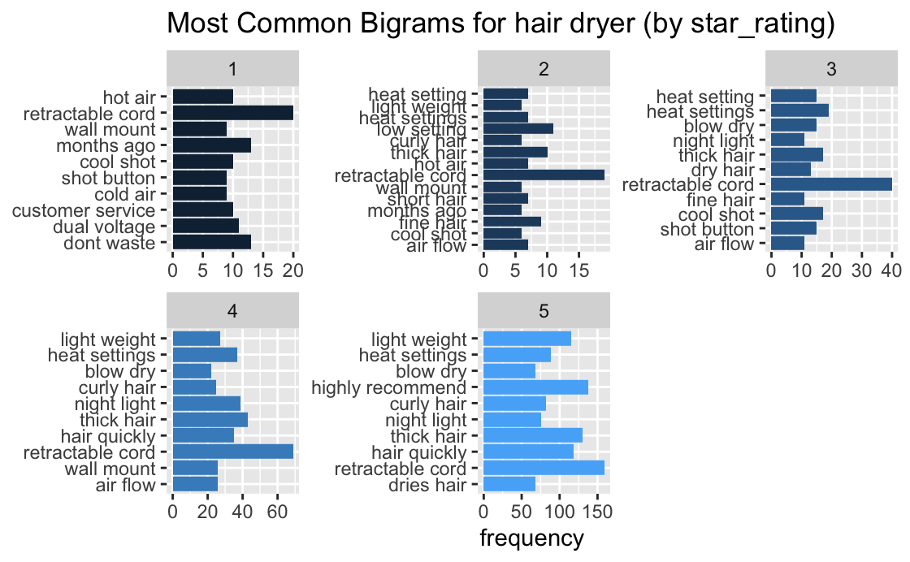
Notes:
Thanks Quan for giving an overview of the current market and customer reviews, next I will dig into the review body to get more helpful insights. First, I extract the most common bigrams from reviews for each star rating level, and visualize them using a barplot. You may wonder what are bigrams, bigram refers to two adjacent words appear together in sentences, you can also think of it as a collocation consists of two words. So, by looking into the most common bigrams in the reviews, we can get more detailed information about hair dryers in the market. For example, for positive reviews like 5-star, we can tell that customers may like the hair dryer with great retractable cord and light weight, which is travel friendly, it may also work perfectly with thick hair. Similarly, by looking into negative reviews like 1-star, we can tell what customers are not satisfied with and what need to be improved. For example, the hair dryer may be labeled as a dual voltage device yet does not work as expected, or the seller has a bad customer service that cause issues.

Slide 14
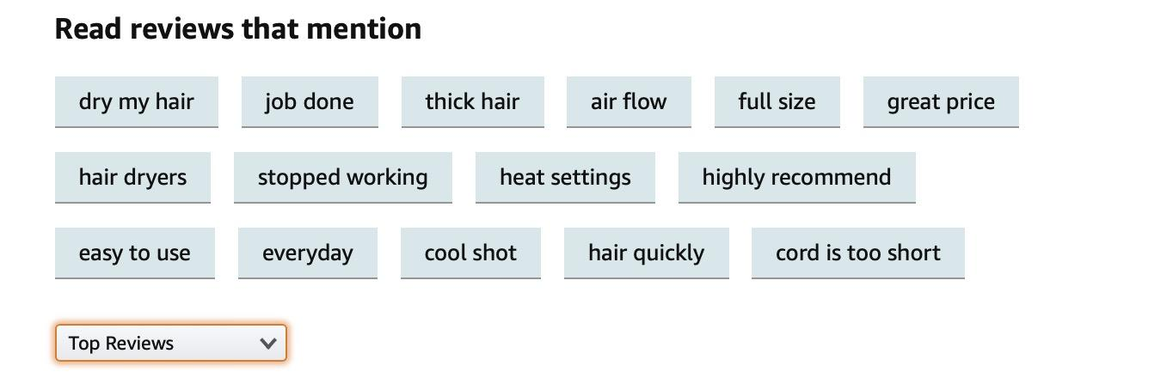
We can do this on all similar products
to gain insights
Notes:
So, how this analysis help sellers on Amazon? If we get into the detailed web page of a random hair dryer on Amazon, we can also see that customers can filter current reviews using similar keywords. Not surprisingly, the key words nearly overlap with the bigrams we extracted especially for the product features. The only difference is that with the data collected from all similar products in the marketplace, we can explore customer reviews on a higher level instead of focusing on only one specific product, and correspondingly, provide more insights for small business and independent sellers who want to enter the e-commerce platform.

Slide 15
Insights
Possible product features to notice:
Retractable cord, Heat setting,
Light weight, Dual Voltage, Night light…...
Possible advertising strategies:
Highlight the key features customers care the most on Ads
Focus on what current products did poor
Notes:
With such information, we can answer the questions quan mentioned before. In this case, if an independent seller want to know what are the features of hair dryer they should focus on before entering the market
competitive advantage
They can also get other insights like have good customer service and friendly return policy may attract more customers.
Next yulin will talk about how amazon currently helps small business using data and our recommendations for the two issue mentioned at the beginning.

Slide 16
What Amazon does:
MORE?
Provide data directly to independent sellers to help them manage their businesses
Help small business learn what is selling well in the Amazon stores by ranking to find the best sellers
Notes:
Based on our previous case, we can know that data analysis is really important for small business to survive in this competitive market. However, Amazon actually have two ways to provide help to these small businesses.

Slide 17
Recommendation 1
Get into competitive selling environment:
Using data analysis help gain an overview of the current market
Learn about how to set the price with more sales data
Using time-based data to predict market trend
Notes:
Data analysis is really powerful, if the small business can get more data, they can gain the overview of the current market before get into the market. Through analysing more Amazon sales and customer dataset, the small business can know what sells and when, what customers ask and search for, which brands are on the rise, how to set the product price, and so on. They even can use the time-based data to predict market trend. Small businesses can survive in this competitive market by analysing these data.

Slide 18
Recommendation 2
Products do not sell themselves:
Using data analysis help independent sellers to better understand and customers’ preferences
Know what products to sale and how to sale them by come up with more effective sales/promotion strategies
Notes:
Based on the previous EDA, it is clearly to see that analysing the customer reviews can help small business to better understand and reach customers on what kind of features that they need for the product. Thus, the small business can choose the right product or producing the right product to satisfied their customer’s need. Also, the small business can advertise their products based on these customer need features. They can also write these feature directly into the product title, thus improving the probability that customers can see their product through searching on the Amazon. Once they get on the right track, they have higher probability to succeed.

Slide 19
Thanks for Listening

Slide 20
References
https://www.aboutamazon.com/news/how-amazon-works/supporting-small-businesses-with-tools-insights-and-data
https://cdn.advocacy.sba.gov/wp-content/uploads/2019/04/23142719/2019-Small-Business-Profiles-US.pdf
https://www.digitalcommerce360.com/2021/02/15/ecommerce-during-coronavirus-pandemic-in-charts/
https://www.smart-minded.com/en/business/best-products-to-sell-on-amazon/

Slide 21
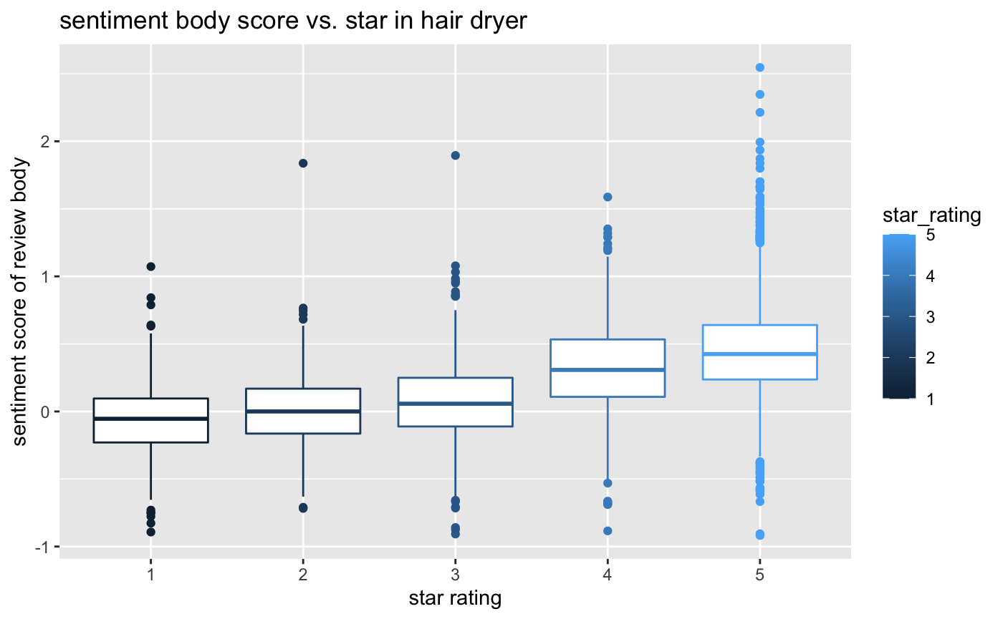
Sentiment Analysis

Slide 22
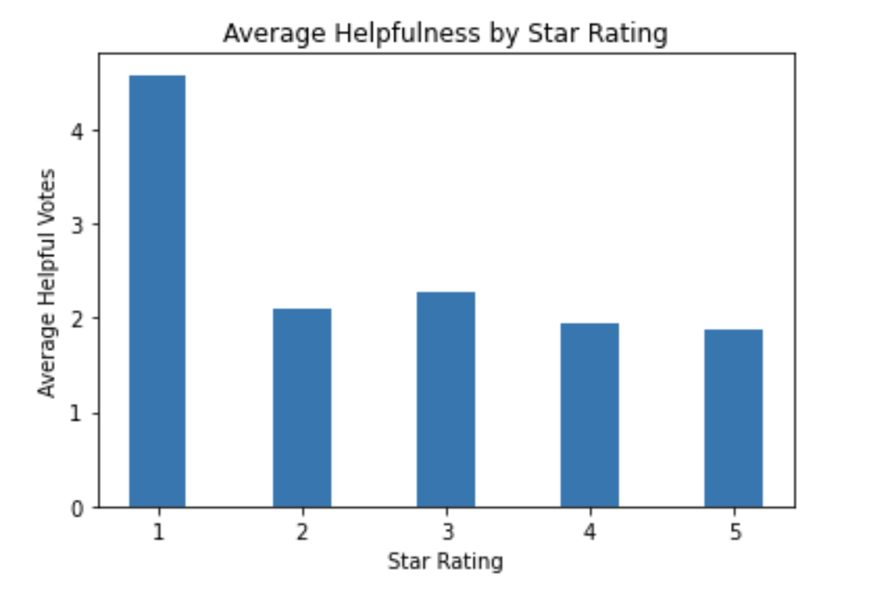
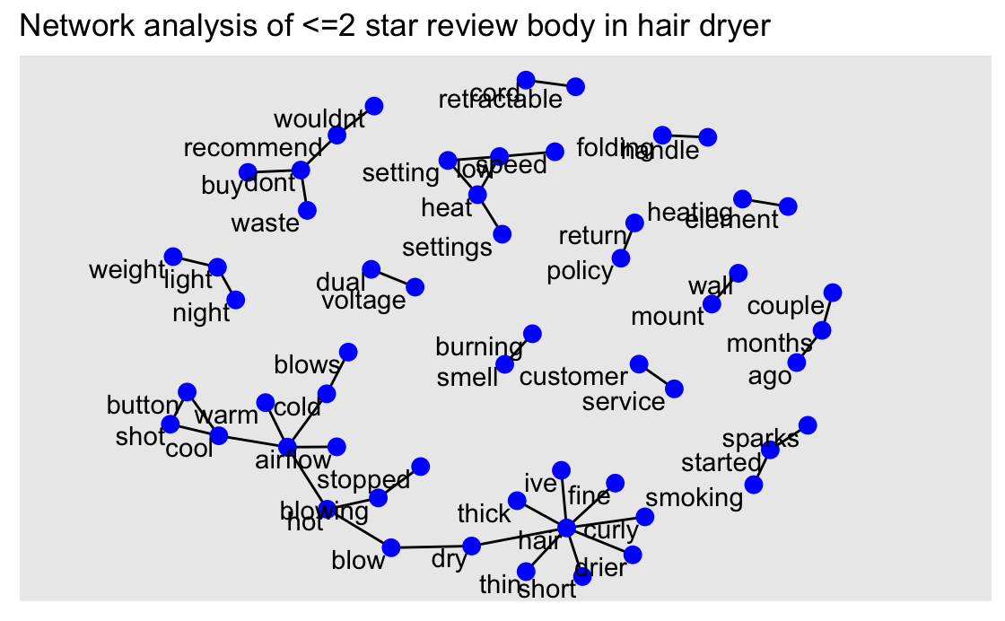
Analysis of Negative Reviews
Most helpful

Slide 23
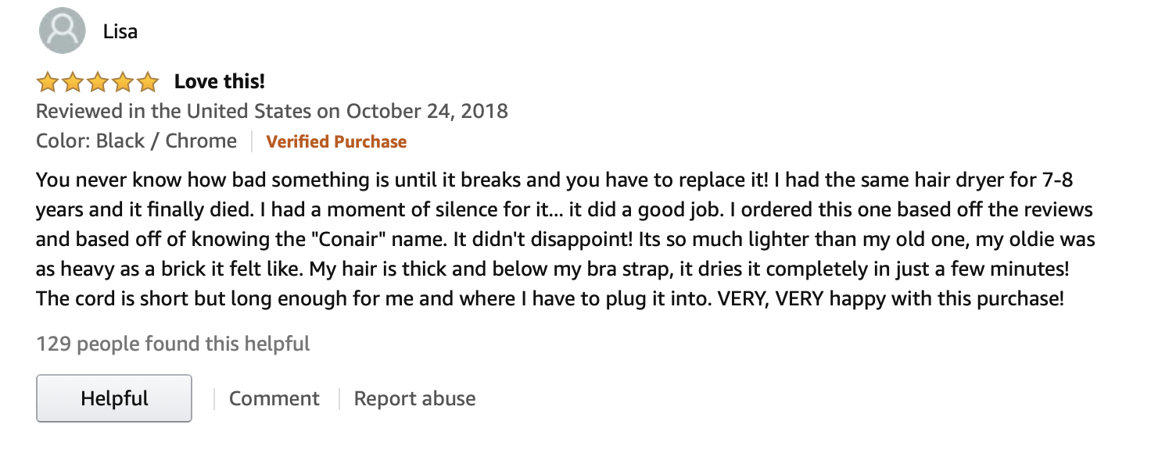
Example of Customer Review

